Slide 1
PIZZA SALES ANALYSIS USING SQL
BY :- RITIKA PRAKASH BATCH NAME:- MIP-DA-12

Slide 2
OBJECTIVE
The goal of Pizza sales analysis using SQL project, is to analyze pizza sales data to gain insights into customer behavior, popular pizza types, sales trends, and overall performance. The analysis will be carried out using the following four tables: order_details, orders, pizza_type, and pizza.

Slide 3
DATASET :
Order_Details
• Order_details_id: Unique identifier for the order detail.
• Order_id: Identifier linking to the orders table.
• Pizza_id: Identifier linking to the pizza table.
• Quantity: Number of pizzas ordered.
2) Orders
• Order_id: Unique identifier for the order.
• Date: Date the order was placed.
• Time: Time the order was placed.

Slide 4
3) Pizza_Type
• Pizza_Type_id: Unique identifier for the pizza type.
• Name: Name of the pizza.
• Category: Category of the pizza (e.g., vegetarian, meat, etc.).
• Ingredients: List of ingredients used in the pizza.
4) Pizza
• Pizza_id: Unique identifier for the pizza.
• Pizza_type_id: Identifier linking to the pizza_type table.
• Size: Size of the pizza (e.g., small, medium, large).
• Price: Price of the pizza

Slide 5
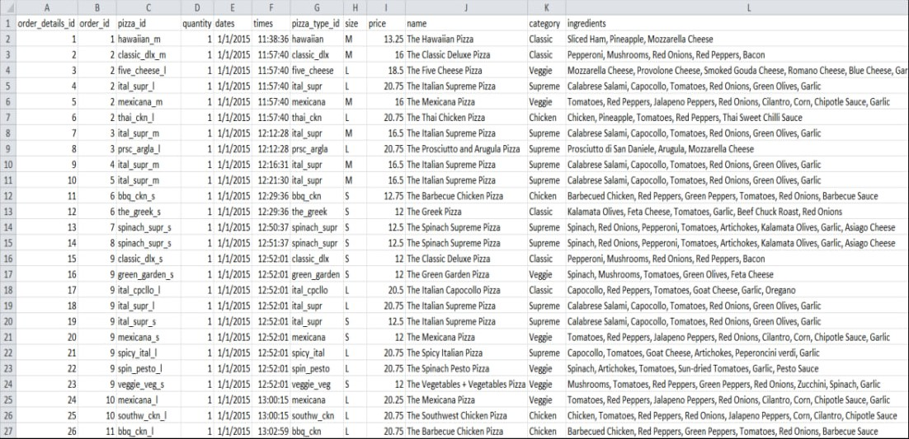
CUMULATIVE DATASET

Slide 6
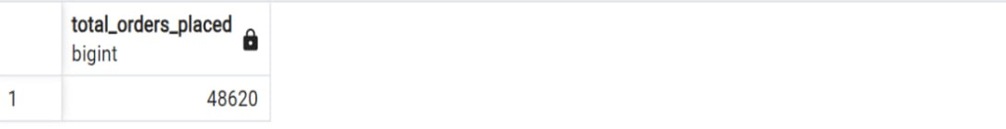
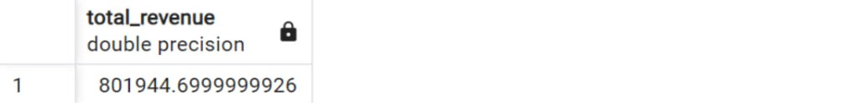
PROBLEM STATEMENTS AND SOLUTION QUERIES

Slide 7
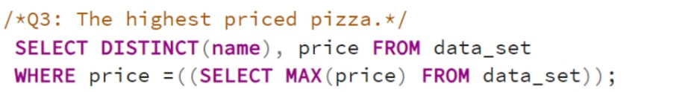

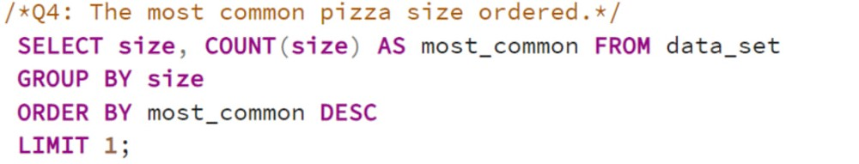
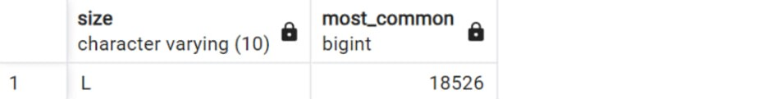

Slide 8
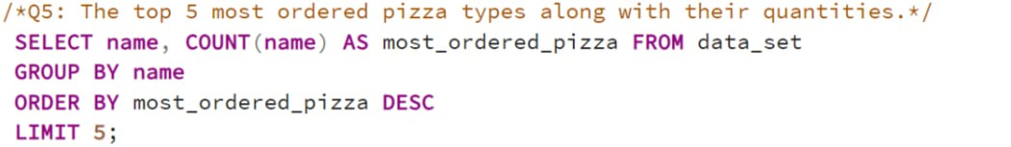
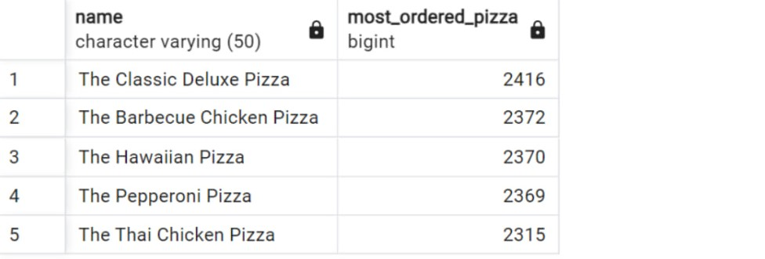

Slide 9
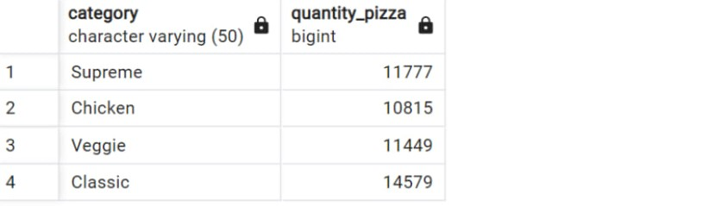

Slide 10
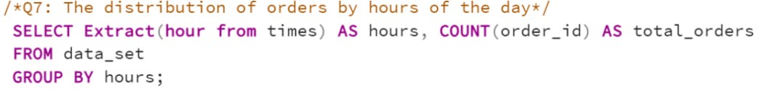
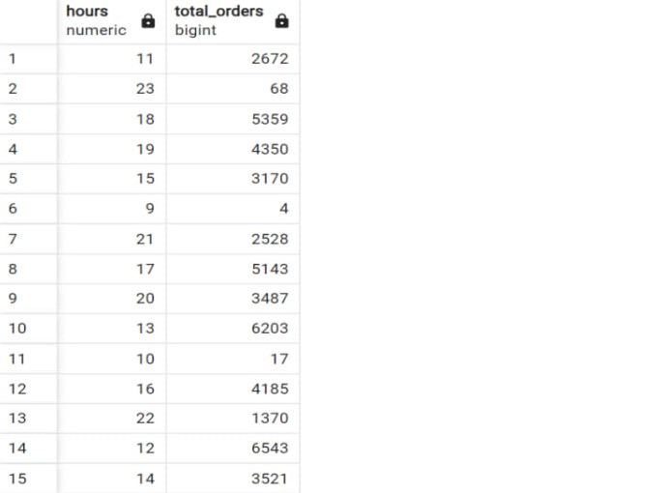

Slide 11
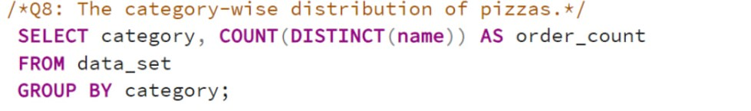
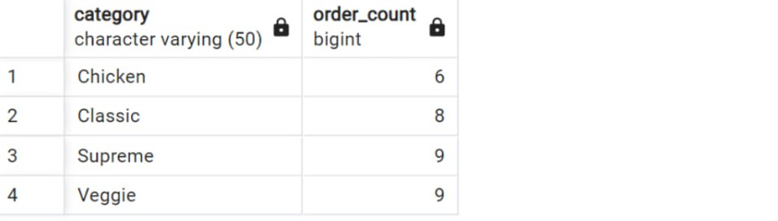

Slide 12
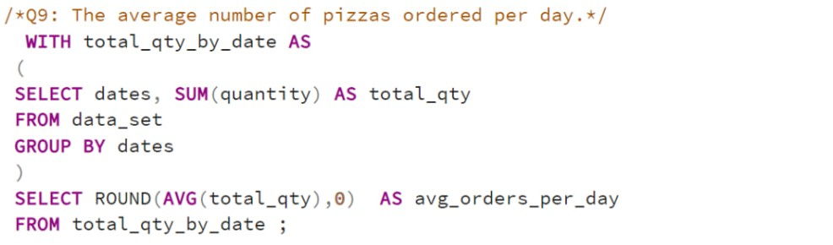
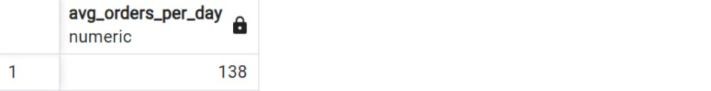

Slide 13
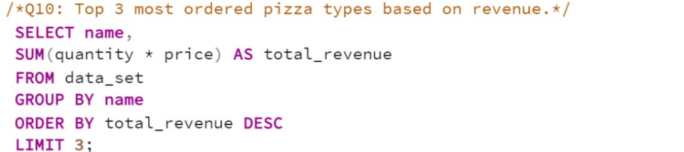
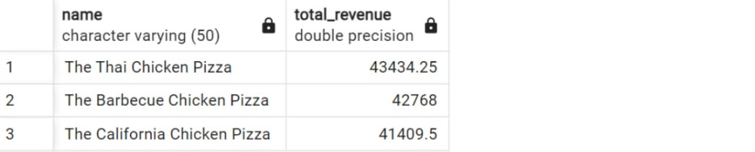

Slide 14
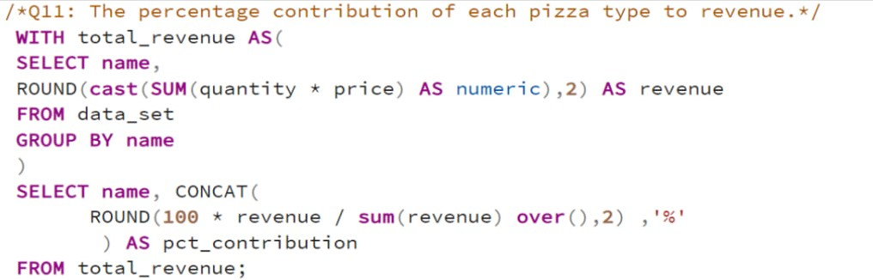
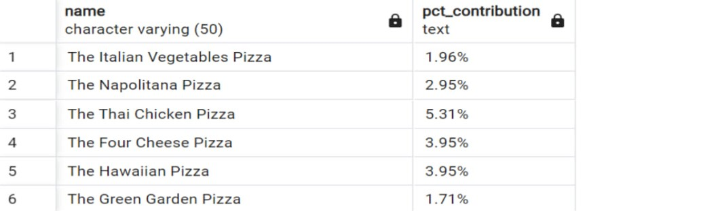

Slide 15
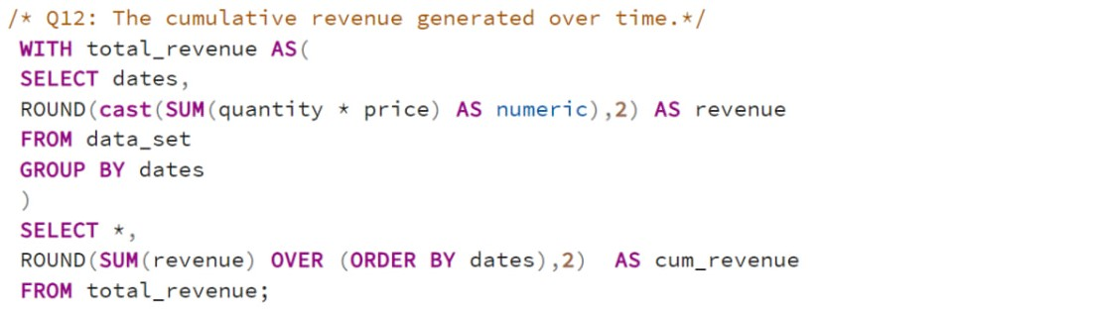
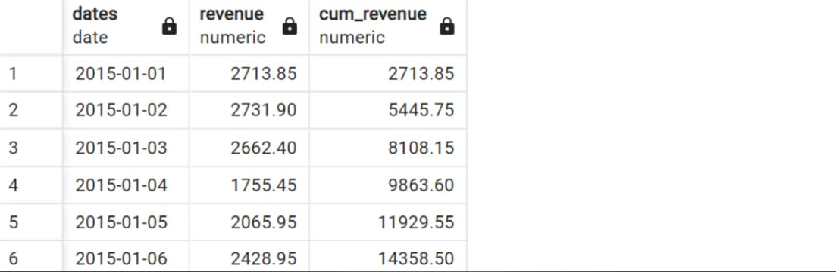

Slide 16
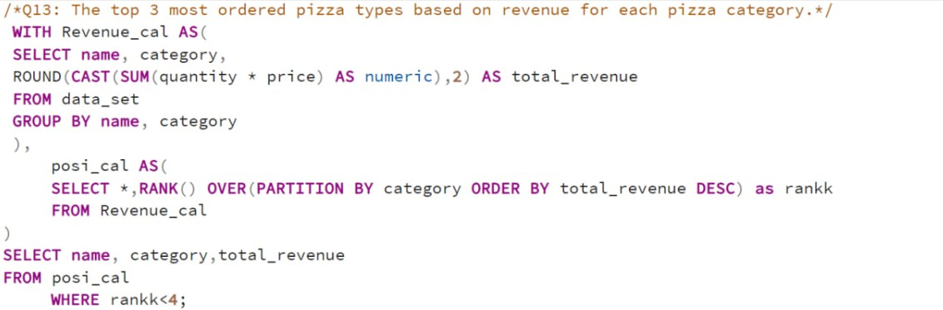
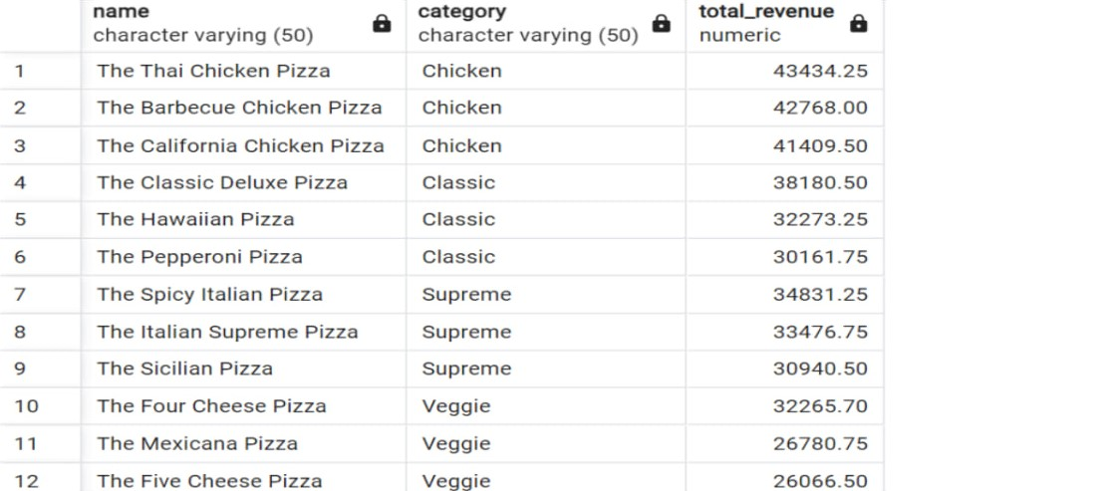

Slide 17
INSIGHTS
• The Pizza store's menu offers a diverse range of 32 unique types of pizzas, which is a good variety for customers to choose from.
• The store received a total of 21,350 orders, resulting in the sale of 48,620 pizzas in 2015.
• The most common ordered Pizza size is “L” with count of 18526.
• The Thai Chicken pizza is the most ordered pizza based on the revenue with a figure of 43434.25
• The peak hours of pizza orders are between 12PM and 1 PM respectively.
• The classic category of pizza is ordered the most with a count of 14579.
• The Greek pizza is the highest priced pizza with price of 35.95.

Slide 18
CONCLUSION
• Best and Worst Selling Pizzas : The best-selling pizza is often identified through SQL queries, which help in understanding the most popular items and their performance.
• Total Revenue and Average Revenue : SQL queries are used to calculate the total revenue generated and the average revenue per pizza, which are crucial metrics for business decision-making.
• Peak Hours and Days : Analysis reveals peak hours and days, which are essential for optimizing staffing and inventory management. For example, peak hours are often between 12pm and 1pm, and peak days are Fridays and Saturdays.
• Average Pizzas per Order : The average number of pizzas per order is calculated to understand customer behavior and optimize menu offerings.
• Business Insights : These projects provide actionable insights for product management, pricing strategies, and marketing efforts. They help in identifying opportunities for growth and efficiency improvements.

